Slide 1

Sentiment Analysis of Amazon Sales Review Using Multinomial Naive Bayes Method
Danica Alana Sjurjahady

Slide 2

About Me
Hello everyone! My name is Danica Alana Sjurjahady.
I’m a fresh graduate majoring in Agro-Industrial Technology from University of Darussalam Gontor, who have a strong interest in data science and data analysis.
Have a good understanding of basic concepts of statistics and machine learning. Skilled in using MySQL, Python, Google Looker Studio, Google Colab, and Microsoft Power BI. Ready to learn and grow in the role of Data Analyst.

Slide 3

Introduction
Objectives
This dataset is having the data of 1K+ Amazon Product's Ratings and Reviews as per their details listed on the official website of Amazon.
You can access the dataset through this hyperlink: Amazon Sales Dataset
This project is a sentiment analysis project using a machine learning model. It analyzes Amazon product reviews to determine whether the sentiment expressed is positive, negative, or neutral. The project uses a dataset of Amazon product reviews (amazon.csv) and applies a Multinomial Naive Bayes model for classification.
Developing a model that can accurately classify the sentiment of Amazon product reviews.
Cleaning and preparing the data for modeling, including handling missing values, removing duplicates, and converting ratings to sentiment labels.
Using TF-IDF (Term Frequency-Inverse Document Frequency) to convert text reviews into numerical representations for the model.
Assessing the accuracy and performance of the trained model using metrics such as accuracy and classification report.

Slide 4





Tools Used

Slide 5
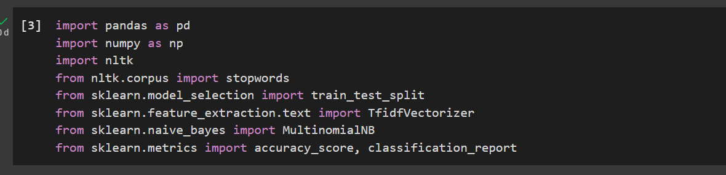
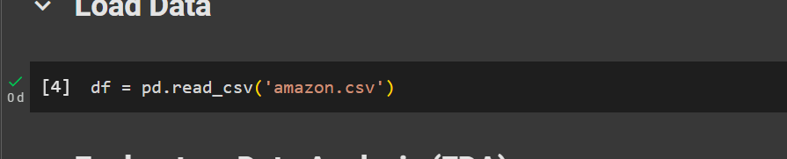
Library Preparation and Data Loading
Before starting to process data, it is necessary to prepare the necessary libraries, such as pandas (used for data manipulation and analysis), NumPy (used for numerical computing in Python), NLTK (used for natural language processing in Python), and scikit-learn (used for machine learning and statistical modeling).
This line of code reads the data from the 'amazon.csv' file and stores it in a pandas DataFrame called df, allowing to work with the data within the Python code.

Slide 6
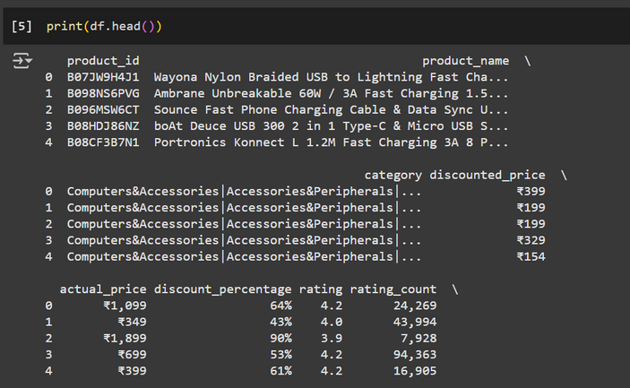
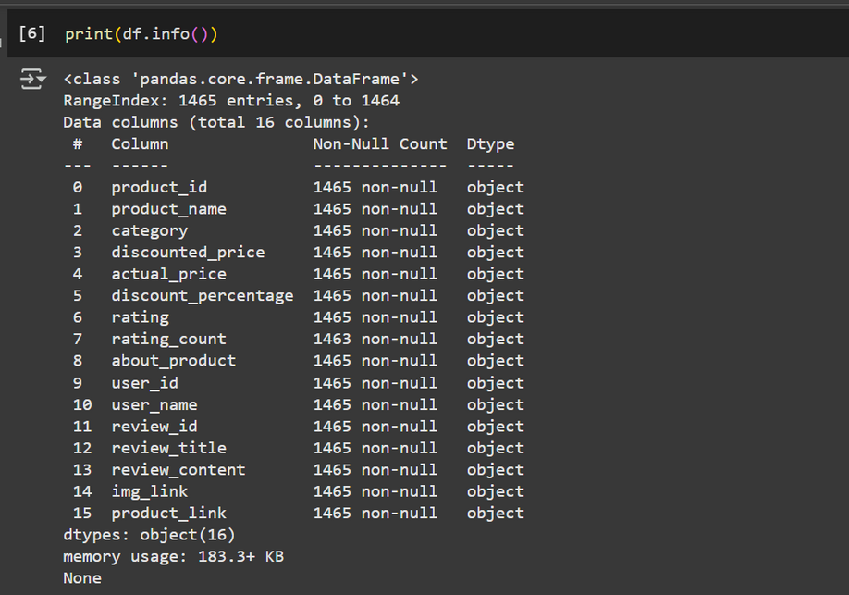
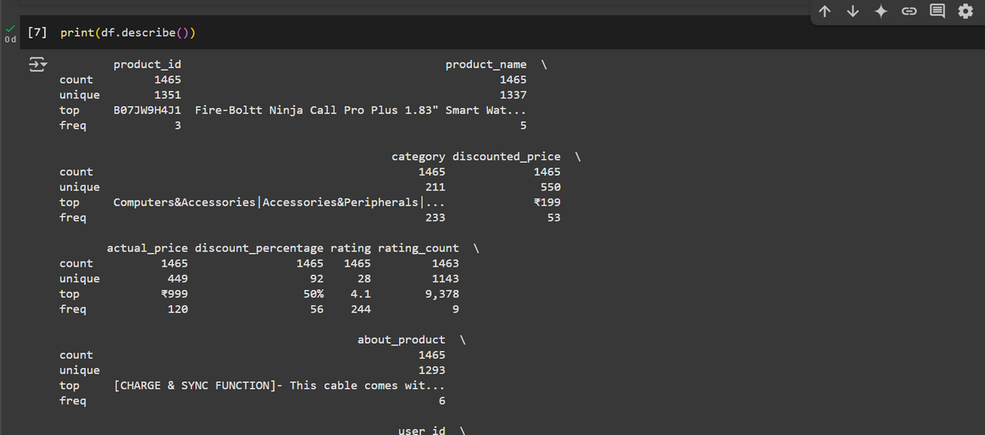

Exploratory Data Analysis (EDA)
This line of code helps the user getting a quick preview of the data you're working with, by taking the data table df, selecting its first 5 rows, and then showing those rows on the screen.
This line of code will display several things, such as total number of rows and columns in DataFrame, etc. This crucial step provides a quick overview, allowing to understand the type of data and spot potential issues like missing values.
This line of code asks for a summary of the numerical data. It will tell the average rating, the highest price, the lowest price, and other useful statistical information about the data.

Slide 7
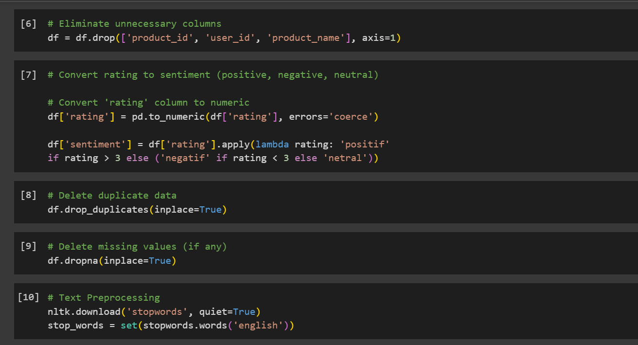
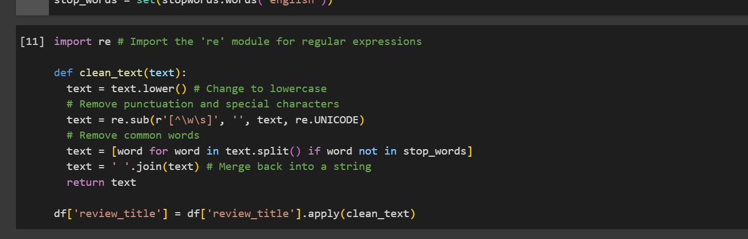
Data Preprocessing
These lines of code aim to clean and prepare the book review text data for sentiment analysis. In short, these codes prepare book review data by cleaning irrelevant data, converting ratings to sentiments, removing duplicate and empty data, and cleaning the review text so that it is ready for further analysis.

Slide 8
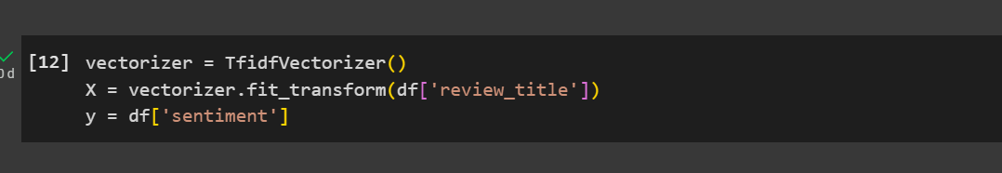
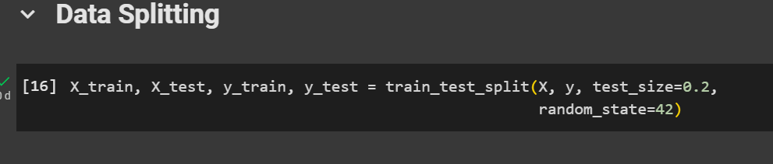
Feature Extraction & Data Splitting
These lines of code take the text data (review titles), transform them into a numerical representation using TF-IDF, and create the input (X) and output (y) variables needed for training a machine learning model to predict sentiment.
This line of code prepares data for machine learning by splitting it into training and testing sets, ensuring a consistent and reproducible split for model evaluation.

Slide 9
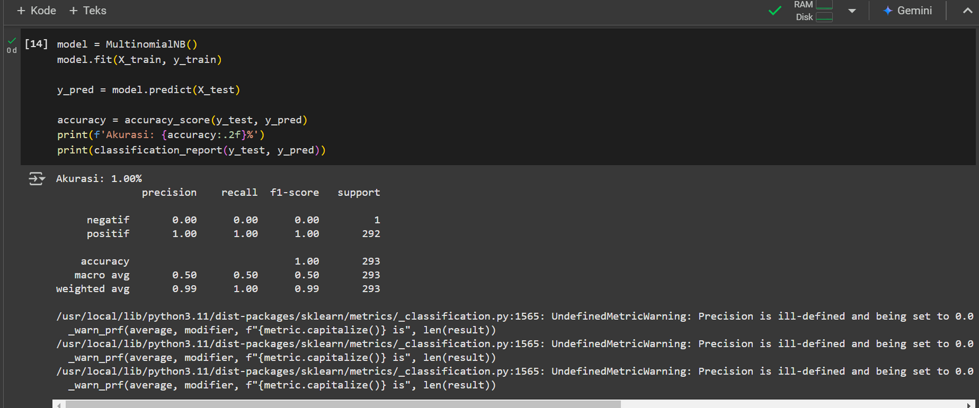
Modelling & Evaluating
These lines of code train a Naive Bayes model for sentiment classification, then test its ability to predict sentiment on new data and measure how well the model performs using accuracy and other metrics.

Slide 10
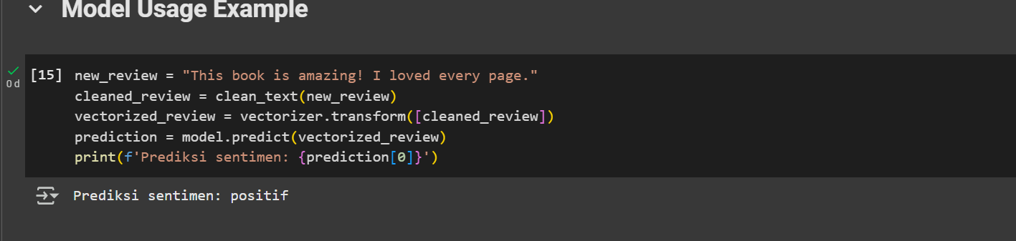
Model Usage Example
These lines of code take a new review, clean it up, convert it into a numerical format that the model can understand, use the model to predict the sentiment of the review, and then display the results.

Slide 11
Conclusion
The project successfully built a sentiment analysis model for Amazon product reviews using a Multinomial Naive Bayes classifier. The model achieved a certain level of accuracy in classifying reviews as positive, negative, or neutral.
The project highlights the importance of data preprocessing and feature extraction in achieving accurate sentiment analysis results, with 100% accuracy. Future improvements could involve exploring other models or using more advanced techniques for feature engineering.

Slide 12



Thank you!
sjurjahady29@gmail.com
If you have any questions, suggestions or feedbacks, please do not hesitate to reach me through these contacts:
github.com/DanicaAlana
linkedin.com/in/danicaas

